Slide 1

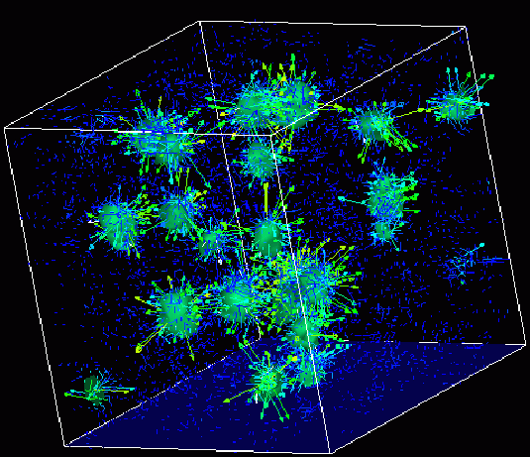
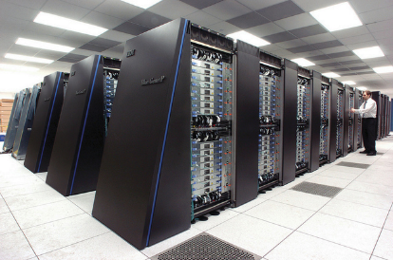
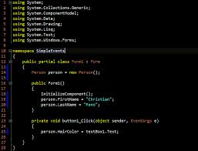
Survey of
Scientific Computing
(SciComp 301)
Dave Biersach
Brookhaven National Laboratory
dbiersach@bnl.gov
Session 16
3D Graphics,
Vector Algebra

Slide 2
Session Goals
Sizing the World Rectangle to frame polynomials
Review 3D Cartesian coordinates and oblique projection
Create a vertex array from a set of Point3D elements
Create a facet from a set of vertices
Draw a wireframe monolith and pyramid
Introduce spherical coordinates ($θ and φ$)
Draw a wireframe sphere and torus
Use vector cross product to perform back face culling
Use vector dot product to perform facet shading

Slide 3
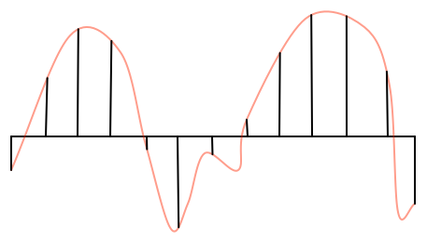
Drawing Curves using Intervals
deltaX
We draw a curve by breaking it into small intervals of straight lines

Slide 4
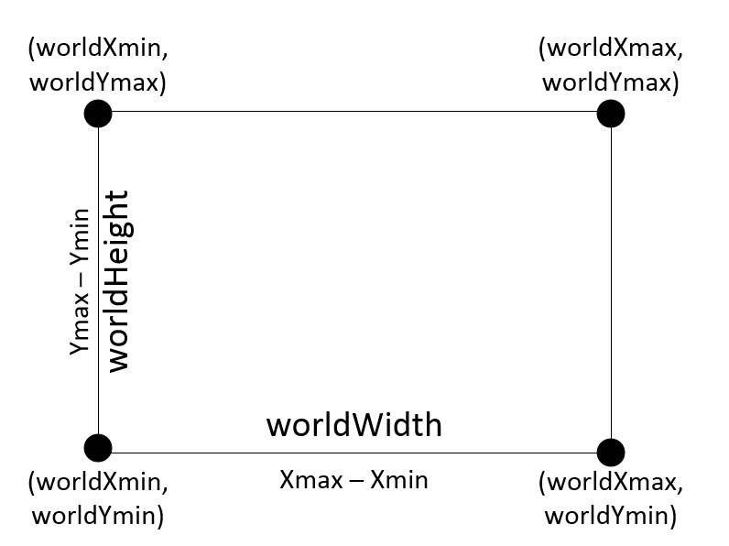

Bounding World Rectangle

Slide 5
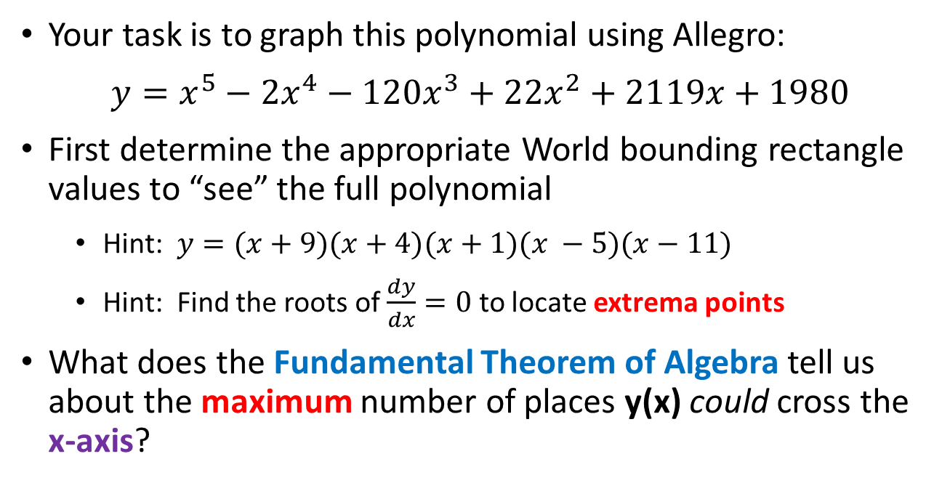
Drawing a Polynomial
Your task is to graph this polynomial using Allegro:
$y=x^{5}−{2x}^{4}−120x^{3}+22x^{2}+2119x+1980$
First determine the appropriate World bounding rectangle values to “see” the full polynomial
Hint: $y=(x+9)(x+4)(x+1)(x −5)(x−11)$
Hint: Find the roots of $\frac{dy}{dx}=0$ to locate extrema points
What does the Fundamental Theorem of Algebra tell us about the maximum number of places y(x) could cross the x-axis?

Slide 6
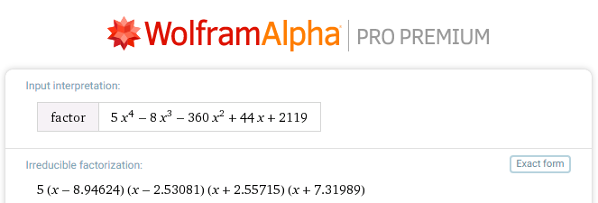
Finding Extrema
$$\frac{dy}{dx}=5x^{4}−8x^{3}−360x^{2}+44x+2119$$

Slide 7
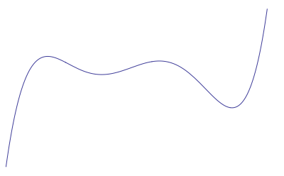
Finding Extrema
(12,31000)
Bounding
World Rectangle
(-10,-20000)
This bounding rectangle should be big enough to see all the interesting parts of the curve

Slide 8
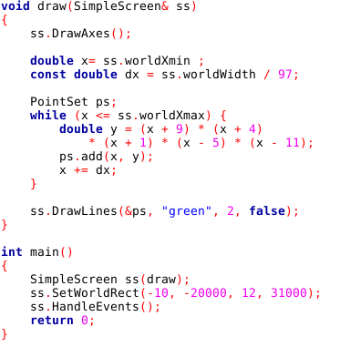
Lab 1 – Draw Polynomial
Prime number to minimize the chance of aliasing
Approximate the curve using small line segments
From the roots & extrema

Slide 9
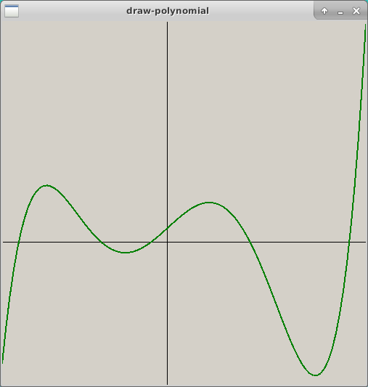
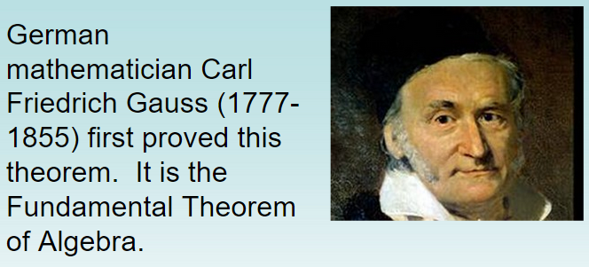
Lab 1 – Draw Polynomial
Open and run Lab 1

Slide 10
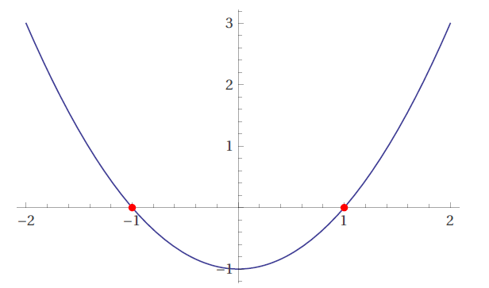
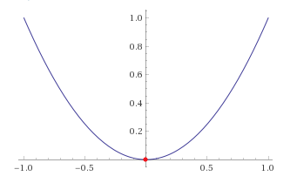
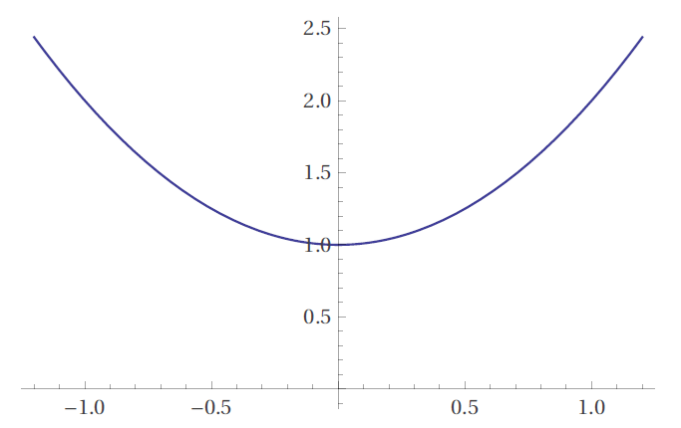






Polynomial Power & Complex Roots
$$y=x^{2}−1$$
Two real roots: $x=±1$
$$y=x^{2}$$
“Two” real roots: $x=0,0$
$$y=x^{2}+1$$
Two $ℂ$ roots: $x=±i$

Slide 11
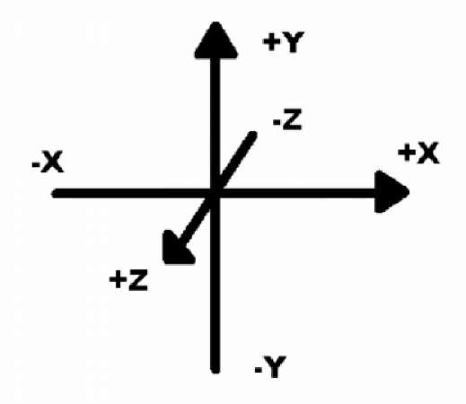
Axis Orientation in 3D
Objects father away have a more negative $z$coordinate value!

Slide 12
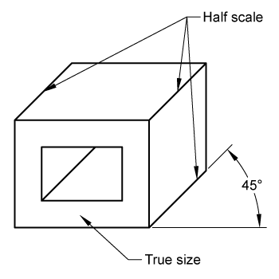
Oblique Projection
In 3-space (world coordinates), these two red points have the same X & Y coordinate values.
They only differ in their Z coordinate values.
The back red point has only a more negative Z coordinate value than the front red point.
y⁺
z⁻
x⁺

Slide 13
Oblique Projection
When drawn in 2-space (screen coordinates), to provide a sense of depth, the back red point needs artificially larger X & Y coordinate values than the front red point X & Y coordinate values.
We adjust the perceived 2D screen X & Y locations of the back red point according to the value of its Z coordinate.
y⁺
x⁺

Slide 14
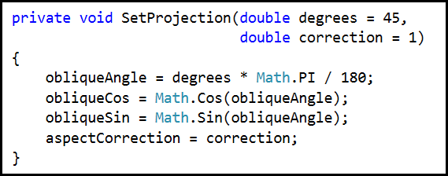
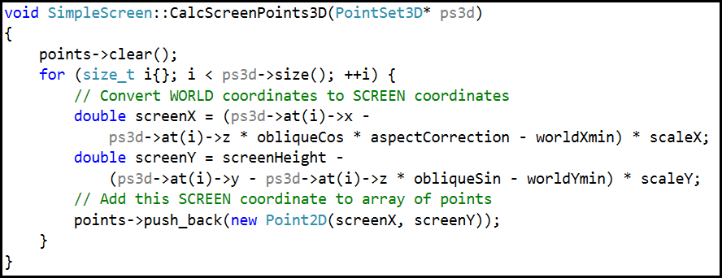
Oblique Projection
Decreasing $z$
y⁺
$$z$$
$$z\sin{θ}$$
$$θ$$
x⁺
$$z\cos{θ}$$

Slide 15
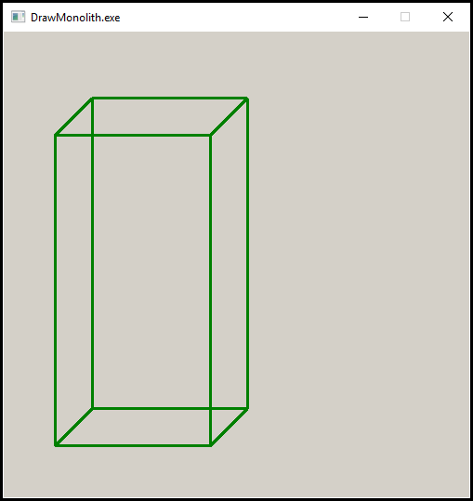
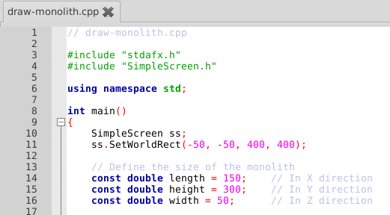
Oblique Projection – Monolith
height
width
length

Slide 16
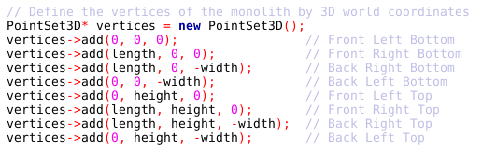
Oblique Projection – Vertex Array
❼
❻
❹
❺
Y+
Z-
❸
❷
⓿
❶
X+

Slide 17
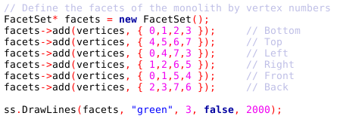
Oblique Projection – Facet Array
Open and run Lab 2
❼
❻
❹
❺
Delay Count
❸
❷
⓿
❶

Slide 18
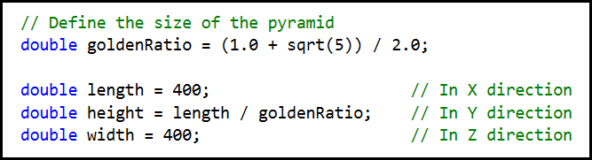
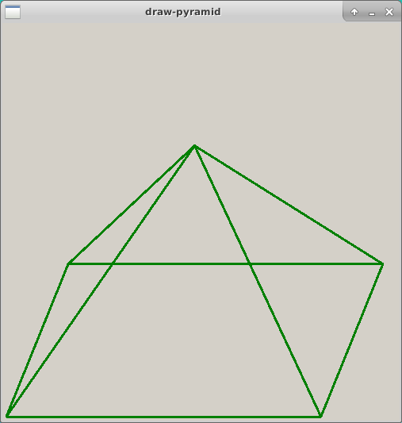
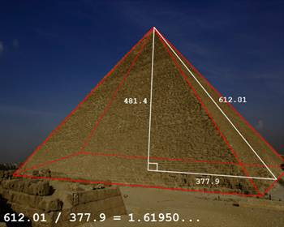
Oblique Projection – Pyramid

Slide 19
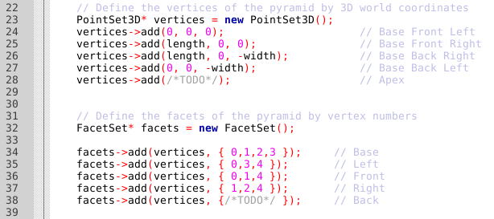

Oblique Projection – Pyramid
Open and edit Lab 3
❹
❸
❷
Remove the two
/* TODO */ comments in the definitions of both vertices and facets, and enter the correct code
⓿
❶

Slide 20
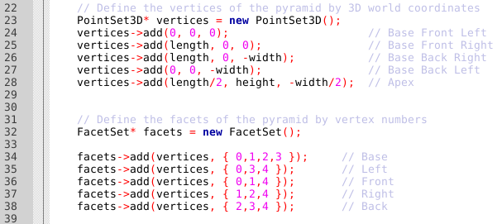
Oblique Projection – Pyramid

Slide 21
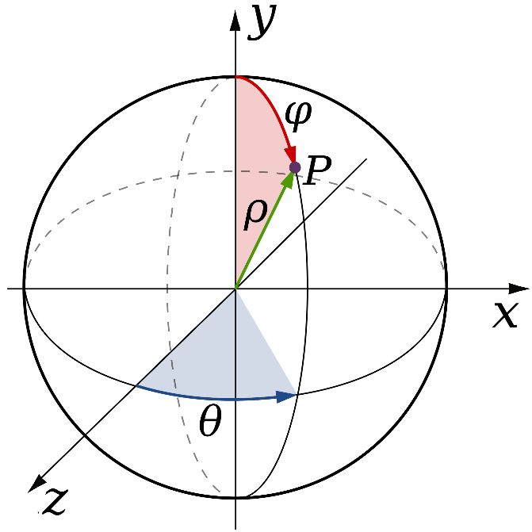
Spherical Coordinates

Slide 22
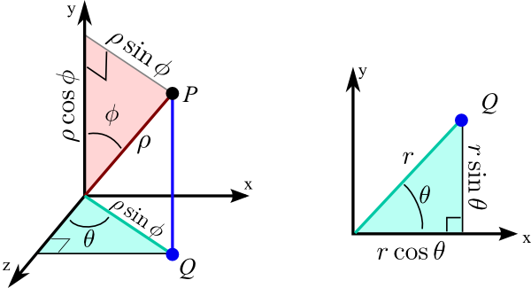
Spherical Coordinates
3D Spherical
2D Polar

Slide 23
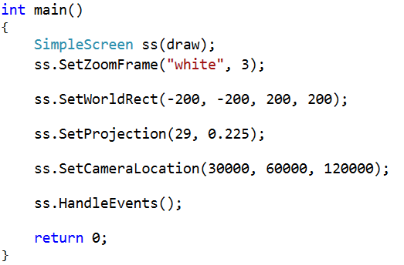
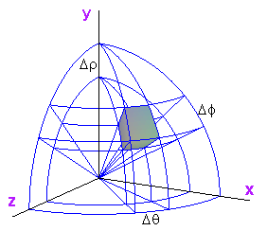
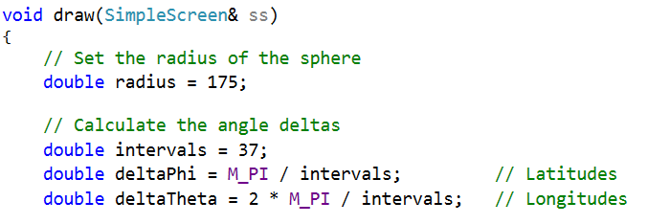
Spherical Coordinates

Slide 24
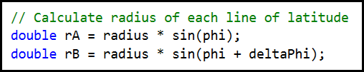





Spherical Coordinates
$$y^{+}$$
$$\sin{ρ}$$
$$radius$$
$$ρ$$
$$r_{a}^{+}$$

Slide 25
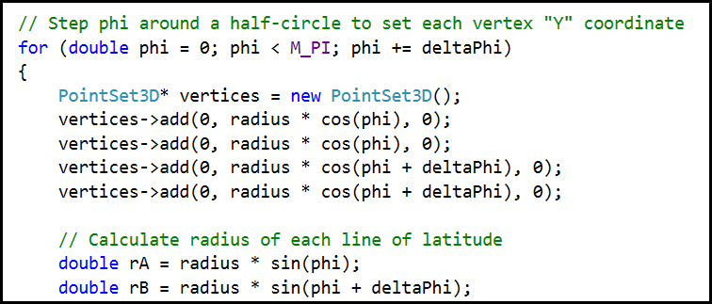





Spherical Coordinates
❶
⓿
$$y^{+}$$
❷
❸
$$radius$$
$$\cos{ρ}$$
$$ρ$$
$$r_{a}^{+}$$

Slide 26
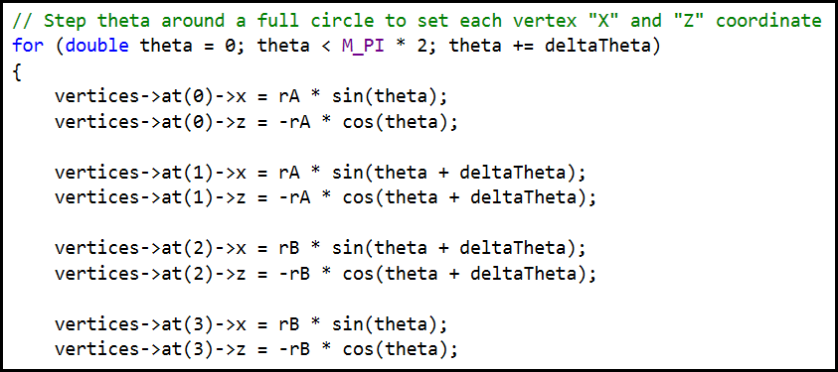
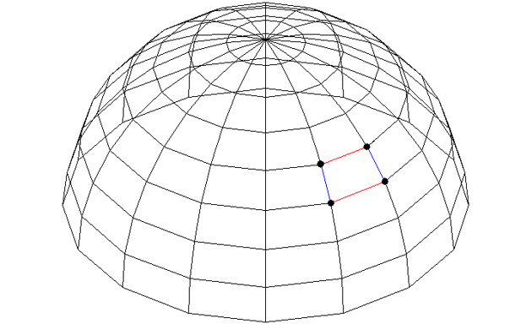






Vertices and Facets
⓿
❶
$$z^{−}$$
❸
❷
$$\sin{θ}$$
$$\cos{θ}$$
$$θ$$
$$r_{a}$$
$$x^{+}$$

Slide 27
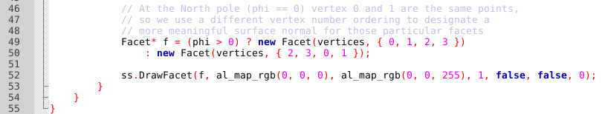
Vertex Winding Order
Open and run Lab 4
⓿
❶
❸
❷
RGB Min
RGB Max

Slide 28
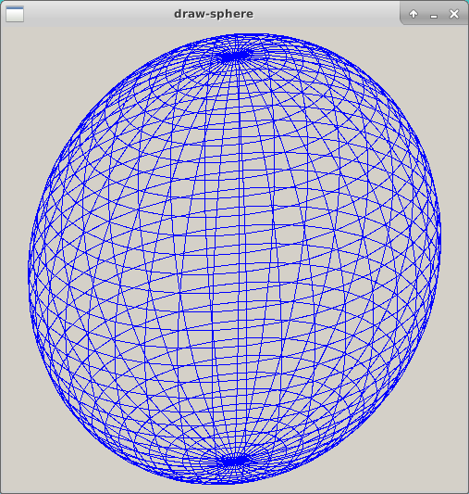
Wireframe Sphere

Slide 29
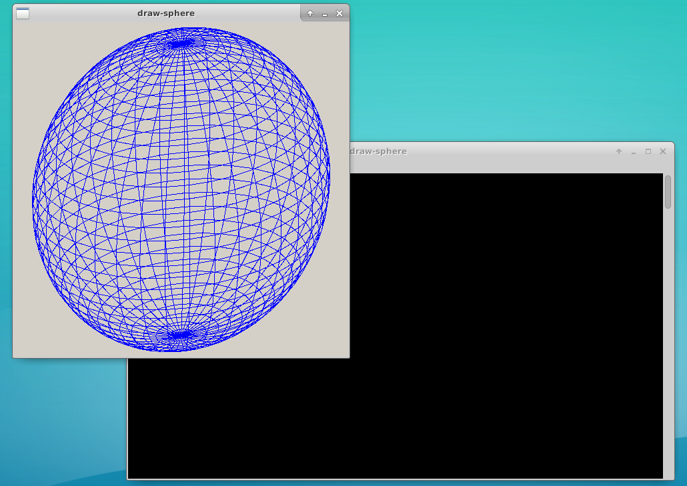
Wireframe Sphere
To close the app, close its Terminal Window

Slide 30
Wireframe Sphere
Delay Count
Re-run Lab 4

Slide 31
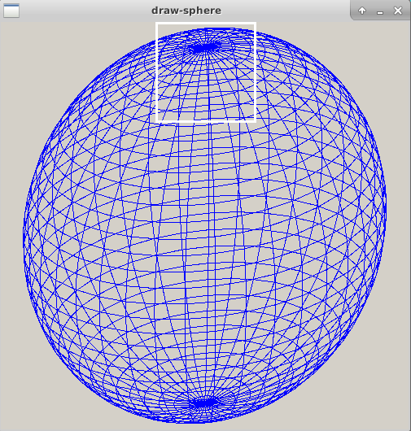
Wireframe Sphere
Left click and drag to create a zoom rectangle

Slide 32
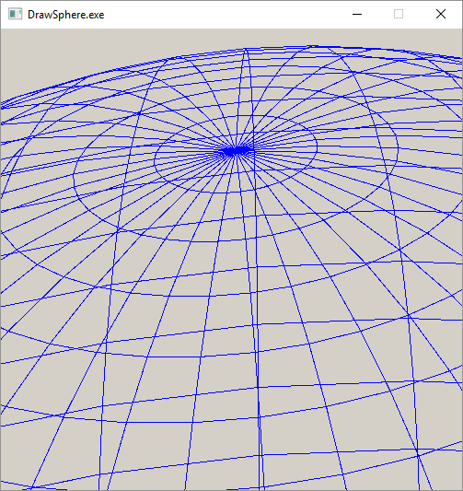
Wireframe Sphere
Right click to restore the prior zoom state

Slide 33
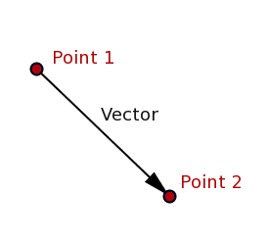
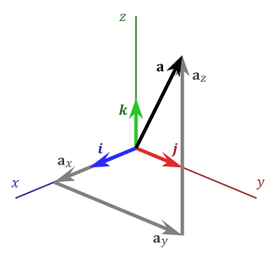
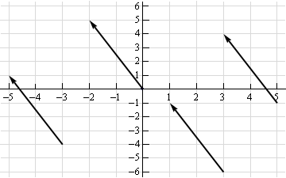
What is a vector?
$a_{x} a_{y} a_{z}$ are the components of
vector$\overset{⃑}{a}$
$$a_{x}={P2}_{x}−{P1}_{x}$$
$$a_{y}={P2}_{y}−{P1}_{y}$$
$$a_{z}={P2}_{z}−{P1}_{z}$$

Slide 34
What is a vector?
How do we avoid drawing the facets which are on the back of the sphere?
$$\overset{⃑}{a}$$
⓿
❶
$$\overset{⃑}{b}$$
❷

Slide 35
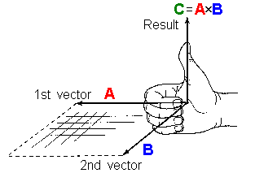
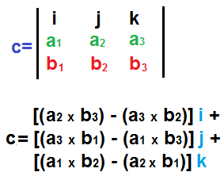
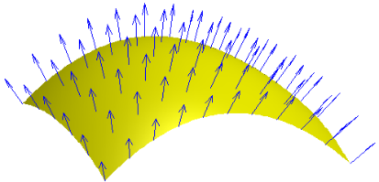
Vector Cross Product
The cross product of two vectors is another vector which is perpendicular to both vectors A and B

Slide 36
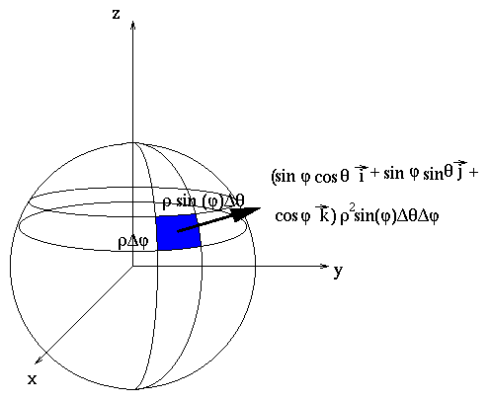
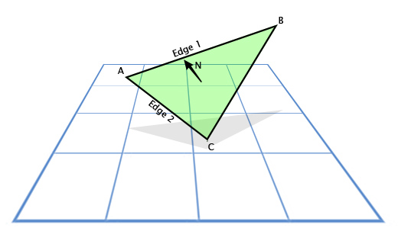
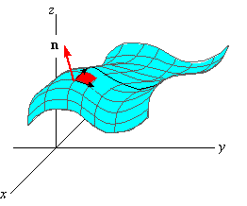

Every Facet has a Surface Normal Vector

Slide 37


Vector Dot Product
The dot product gives the angle between two vectors

Slide 38




Back Face Culling and Facet Shading
$$\vec{n}$$
Camera / Eye Location
$$θ$$

Slide 39

Back Face Culling

Slide 40

Back Face Culling
Re-run Lab 4

Slide 41

Back Face Culling

Slide 42

Facet Shading

Slide 43

Back Face Culling
Re-run Lab 4

Slide 44

Facet Shading

Slide 45




Drawing a Torus
A torus and a sphere are not homeomorphic as we need two defining radii for a torus
$$R_{1}$$
$$R_{2}$$

Slide 46

Drawing a Torus
Open and run Lab 5

Slide 47

Drawing a Torus

Slide 48

Drawing a Torus
Re-run Lab 5

Slide 49

Drawing a Torus

Slide 50
Now you know…
We can use the zeroes and extrema of a polynomial to determine an appropriate world rectangle to frame it
3D Cartesian coordinates use$\left(x,y,z\right)$ while 3D Spherical coordinates use $(r, θ, φ)$
An oblique projection (2.5D) shows a ¾ “side” view
Sets of vertices are assembled into facets
A surface normal vector is a cross product of two facet edge vectors following the right-hand rule
A dot product expresses the angle between two vectors
The dot product between the camera vector and each facet normal enables back face culling and facet shading

